Slide 1
CODE
Knowledge TI

Slide 2

Object-oriented programming System

Slide 3

Abstraction
Abstraction is a process where you show only “relevant” data and “hide” unnecessary details of an object from the user
Burgers
Classic Burger
Chess Burger
Vegan Burger

Slide 4

Encapsulation
It’s a consequence of Abstraction
Encapsulation simply means binding object state(fields) and behavior(methods) together. If you are creating class, you are doing encapsulation.
Class Burger
Attributes
Behavoir

Slide 5

Inheritance
The process by which one class acquires the properties and functionalities of another class is called inheritance.
Burger
Cheeseburger

Slide 6

Polymorphism
Polymorphism is an object oriented programming feature that allows us to perform a single action in different ways
Burger - Cheese Recipe
Burger - Classic Recipe

Slide 7


Slide 8
Best Practice - Java 8+
Implement tight encapsulation, loose coupling and high cohesion in classes
Using Frameworks and tools
Always close IO streams
If you need fast iteration and random access – use ArrayList
If you need fast insertion and deletion – use LinkedList
Using Default Methods in Interfaces
Using Lambdas in Streams
Keep Lambda Expressions Short and Self-explanatory. Remember lambdas should be an expression, not a narrative.
Protect Object Variables from Mutation.
Using java.util.Optional

Slide 9


Slide 10
Best Practice – Python (3.7+)
Python is NOT an Object-Oriented Programming language.
It is a General-Purpose language optimized for developer speed.
But has very strong OO features.
As well as procedural, functional and reflective features.
Python language doesn’t enforce rules:
Nothing is really private (data or methods).
You can run, but you can’t hide… (ie. MyClass.__private)
Patterns are up to the programmer and
In 2020, you should be using python 3.8 with dataclasses:
It is a highly-configurable, yet easy to use code generator.
Helps write fully featured classes with very few lines of code.
When in doubt: import this
And read the PEP8. (https://www.python.org/dev/peps/pep-0008)
You don’t have to learn it all, just install flake8, mypy and black

Slide 11
Python OOP in one slide:
class MyClass:
def give_answer(self):
return 42
class OtherClass(MyClass):
pass

Slide 12
Python OOP in one slide:
obj = OtherClass()
assert isinstance(obj,MyClass)
assert type(obj) is OtherClass
assert obj.give_answer() == 42
class MyClass:
def give_answer(self):
return 42
class OtherClass(MyClass):
pass

Slide 13
Python Classes 101:
GOTO: classes_01.py
GOTO: burgers_02.py

Slide 14
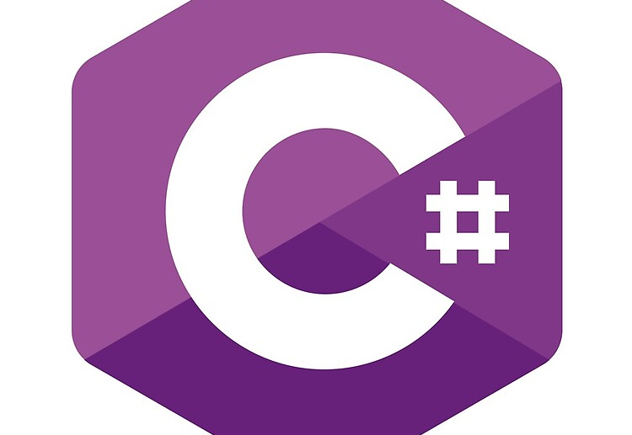

Slide 15
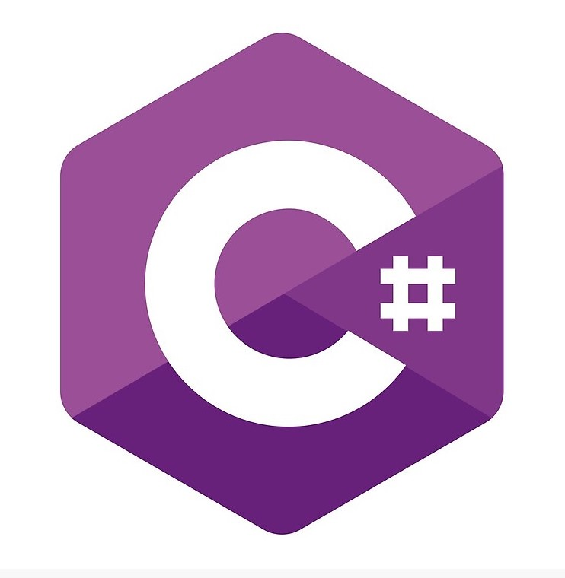
Best Practice C#
Use Proper Naming Conventions
Decide between Value Types and Reference Types
Always Use Properties instead of Public Variables
Use Nullable Data Types Whenever Required
Prefer Runtime Constants over Compile time Constants
Prefer “is” and “as” Operators While Casting
Prefer string.Format() or StringBuilder for String Concatenation
Use Conditional Attributes When You Need Them
Use ‘0’ (zero) as Default Value Enum Value Types
Always Prefer the foreach(…) Loop
Properly Utilize try/catch/fin Split your Logic in Several Small and Simple Methods
ally Blocks
Catch Only that Exception that You Can Handle
Use IDisposable Interface

